Slide 1
Network and Cyber Security-I (CY2001) (Lecture 18)
Dr. Qaisar Shafi
Department of Computer Science,
National University of Computer & Emerging Sciences, Islamabad Campus

Slide 2
“Message Authentication & Hash Functions”
“Cryptographic systems in Practice”
“Introduction to Wireshark”

Slide 3
Message Authentication
Message authentication is a mechanism used to verify the integrity of the message.
Message authentication assures that data received are exactly as sent(contains no modification, insertion, deletion, or replay) and that the purported identity of the sender is valid.
Symmetric encryption provides authentication among those who share the secret key.
Encryption of the message by a sender’s private key also provides a form of authentication.

Slide 4
Techniques of Message Authentication
Two most common cryptographic technique for message authentication are:
Message authentication code(MAC)
Secure Hash function

Slide 5
MAC
A MAC is an algorithm that requires the use of secret key.
A MAC takes a variable-length message and a secret key as input and produces an authentication code.
A recipient in possession of the secret key can generate an authentication code to verify the integrity of the message.

Slide 6
Hash functions
A hash function maps a variable-length message into a fixed length hash value, or message digest.
For message authentication, a secure hash function must be combined in some fashion with a secret key.

Slide 7
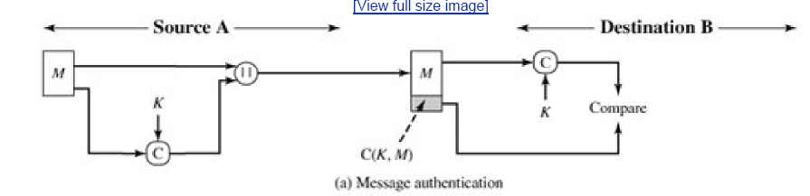
MAC

Slide 8
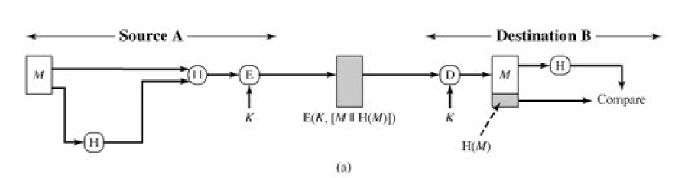
HASH function

Slide 9
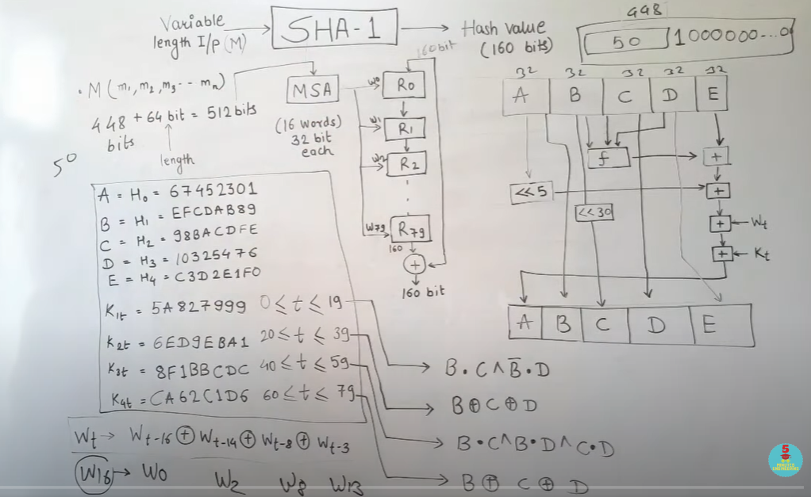

Slide 10
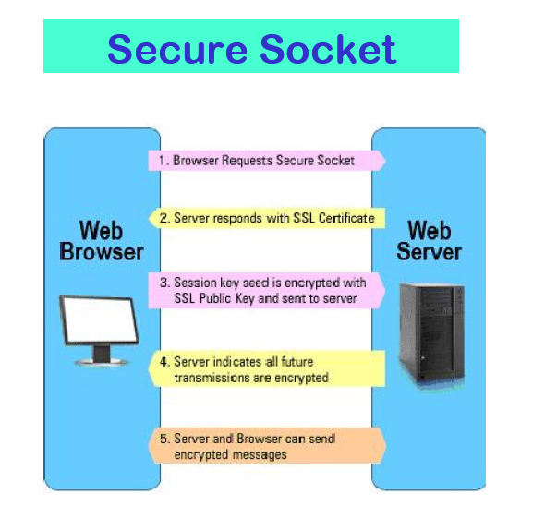

Slide 11
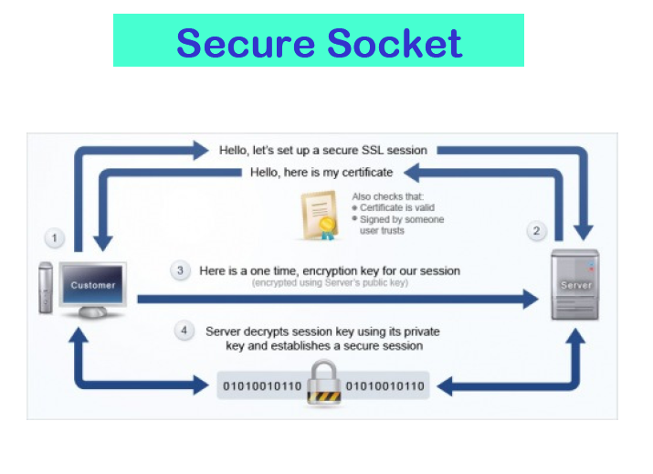

Slide 12
How we going to see these security methods ?
Introduction to Wireshark?
www.wireshark.org
Wireshark is the world's foremost and widely-used network protocol analyzer.
Can sniff communication
Can be used to analyze communication
Can be used to detect attacks
Lets see in practice

Slide 13
Any Questions ?

